Slide 1
Intro to Computers
UT LAW 379M
Spring 2021
Lecture Notes

Slide 2
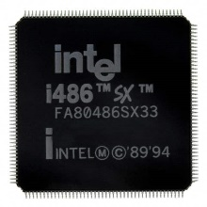
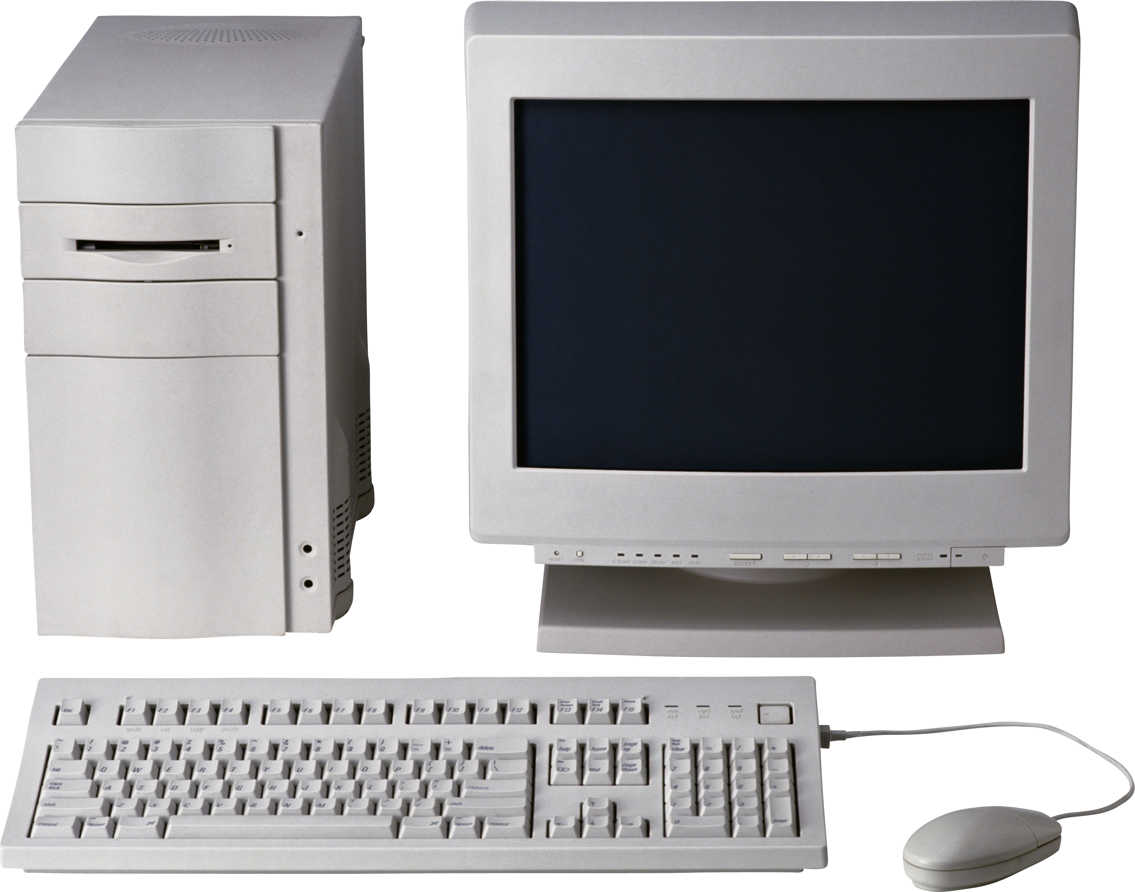
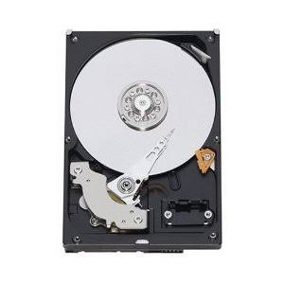
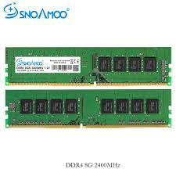
Three Major Computer Parts
Central Processing Unit (CPU)
Hard Drive
Random Access Memory
(RAM)
This Photo by Unknown Author is licensed under CC BY-NC

Slide 3
First, a Word About Data
Computers store and process all data as BINARY NUMBERS
Everything is a binary number. Games, programs, music, etc
The binary numbers are interpreted as letters, music, etc

Slide 4
Quick Binary Lesson
Base 10 Numbers
Base 2 Numbers
10³ = 1000 | 10² = 100 | 10¹ = 10 | 10⁰ = 1
3 | 0 | 9 | 5
(3X1000) + | (0X100) + | (9X10) + | (5X1)
3000 + | 0 + | 90 + | 5
3095
2³ = 8 | 2² = 4 | 2¹ = 2 | 2⁰ = 1
1 | 0 | 1 | 0
(1X8) + | (0X4) + | (1X2) + | (0X1)
8 + | 0 + | 2 + | 0
10

Slide 5
What are These Binary Numbers?
Binary 1000?
Binary 0100?
Binary 0010?
Binary 0001?
Binary 0101?
Binary 1010?
Binary 1111?
Remember 8, 4, 2,1 columns.
If there’s a one, add the column:
0110 = 4+2 = 6
1001 = 8+1 = 9

Slide 6

Decode This Shirt

Slide 7
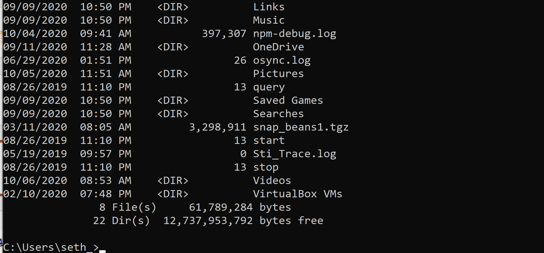
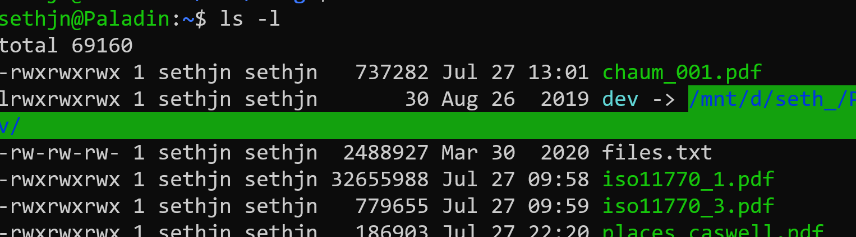
Binary Sizes
A one or a zero is a “bit”
8 bits is a byte
Let’s use our command line to see how big files are:
Open a terminal on Mac or the cmd shell on Windows
Type “ls –l” on Mac or “dir” on Windows

Slide 8
Binary is Often Represented as Hex
Binary is Base 2
For “short hand”, binary is often written in Base 16
This is because there is a 1:1 mapping between 4 bits and 1 Hex number:
0000 – 0 | 0100 – 4 | 1000 – 8 | 1100 – C (hex 12)
0001 – 1 | 0101 – 5 | 1001 – 9 | 1101 – D (hex 13)
0010 – 2 | 0110 – 6 | 1010 – A (hex 10) | 1110 – E (hex 14)
0011 – 3 | 0111 - 7 | 1011 – B (hex 11) | 1111 – F (hex 15)

Slide 9
Interpretation - Letters
ASCII – The original English language character mapping
Each letter, symbol, and control character had a code
‘a’ – 97 (decimal), 0x61 (hex), 0110 0001 (bin)
‘A’ – 65 (decimal), 0x41 (hex), 0100 0001 (bin)
Newline – 10 (decimal), 0x0a (hex), 0000 1010 (bin)

Slide 10
Interpretation - Images
Uncompressed pictures can be 1 number per pixel
Each number is an index into a table of colors
1 bit-per-pixel can do two colors (black and white)
8 bpp can do 256 colors
32 bpp can do 4,294,967,296 colors

Slide 11
(Side Note, Compression)
Images can be compressed with special techniques
Groups of same-color pixels stored together
Videos go even further
I frame, full picture
B frame/p frame, changes from previous picture

Slide 12
Interpretation - Documents
Multi-level encoding
Codes indicate whether text is regular, bold, etc
All the data is rendered by the display program

Slide 13
HTML Example
The entire document, except for media, is text
So, there is “interpretation” from binary to text
And more “interpretation” from text to codes
Example:
<B>This is bold</B>
The <B> says “all text until next </B>” is bold

Slide 14
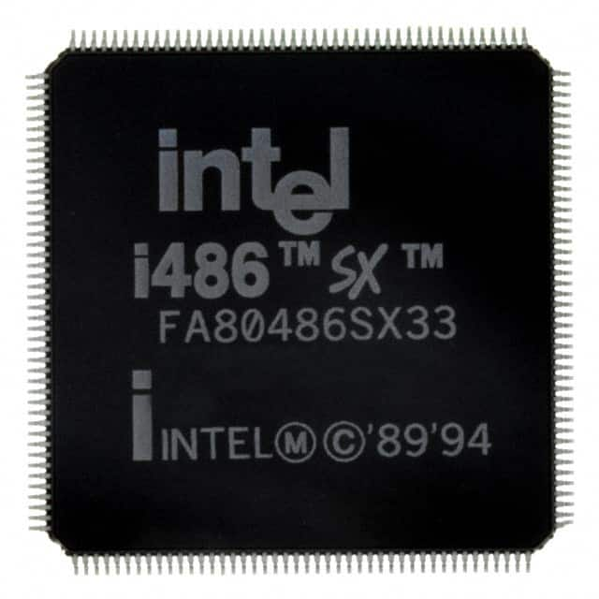
Processors and Binary
Computer “Instruction” is just a binary number. In older computers, like the 486 shown here, it was 32-bit. In more modern processors it is 64-bit.
1 | 0 | 0 | 1 | 1 | 0 | 0 | 0 | 0 | 1 | 1 | 0 | 0 | 1 | 0 | 0 | 0 | 0 | 1 | 1 | 1 | 1 | 1 | 0 | 1 | 0 | 1 | 0 | 0 | 1 | 1 | 0

Slide 15
CPU Instructions
The instruction is broken down into pieces. One part is called the “op code” or operation code, it tells the computer what to do. The other parts are parameters. Each instruction “add”, “subtract,” etc. has its own op code.
1 | 0 | 0 | 1 | 1 | 0 | 0 | 0 | 0 | 1 | 1 | 0 | 0 | 1 | 0 | 0 | 0 | 0 | 1 | 1 | 1 | 1 | 1 | 0 | 1 | 0 | 1 | 0 | 0 | 1 | 1 | 0
OP CODE
PARAMETER 1
PARAMETER 2

Slide 16
Program Stored On Disk
32-bit instruction
32-bit instruction
Program is a list of instructions
Processor executes one at a time.
Some instructions are “branches”
A branch jumps ahead or behind in the list
Often “conditional” (e.g., if x > 0 then jump)
32-bit instruction
32-bit instruction

Slide 17
Running a Program
HARD DRIVE
Program
(List of Instructions)
RAM
Program
(List of Instructions)
Single Instruction
Program is
copied to RAM
(RAM is faster)
1 Instruction at a time
loaded by the processor

Slide 18
Data Too
HARD DRIVE
Program
(List of Instructions)
RAM
Program
(List of Instructions)
Data
Single Instruction
Data File
Instruction can manipulate instructions (branching), read or write from data in RAM or load or save data from files on disk. (All are just binary numbers)

Slide 19
Creating a Program
Programs written in Programming Language
Programming Language is human readable
However, programming language NOT machine readable
Remember, processor ONLY speaks in basic instructions

Slide 20
Compiling
Some languages can be “complied”
This means the program is converted to machine readable
Compiler knows how to translate and organize
Quite complicated and still subject of research
Example: C/C++

Slide 21
C Example
#include <stdio>
int main(void) {
printf(“Hello World\n”);
return 0;
}
COMPILER
1100101001111010101
1010010101001110101
1010101111101110000
1010101010001111000

Slide 22
Interpreting
Some languages can be “interpreted”
This means the program is “executed” by interpreter
Usually one instruction at a time
Interpreter has to be a fully compiled program
Interpretation is considerably slower
Example: Python

Slide 23
Python Example
if __name__ == “__main__”:
print(“Hello World”)
PYTHON INTERPRETER
(Already Binary Program)
print(“Hello World”)
1100101001111010101

Slide 24
Virtual Machine
An extreme form of “interpreting”
Virtual processor with virtual instructions
Programs are compiled to the virtual instructions
Virtual instructions executed on the virtual processor
Virtual processor translates instructions to host machine code
Example: Java

Slide 25
Java Example
import System;
class HelloWorld {
static int main(void) {
System.Out.println(“Hello World!”);
return 0;
}
}
Java Virtual Machine
COMPILER
1100101001111010101
1100101001111010101
1010010101001110101
1010101111101110000
1010101010001111000

Slide 26
Why This is Useful
Everything in a computer is a number. Programs, Data, etc
This is great because programs and data can be stored the same way
Everything can be copied over a network the same way

